Slide 1
Data Structures and Algorithm
Introduction to Data Structure
Linked List

Slide 2
What is Data Structure?
Data structure is a representation of data and the operations allowed on that data.
  A data structure is a way to store and organize data in order to facilitate the access and modifications.
  Data Structure are the method of representing of logical relationships between individual data elements related to the solution of a given problem.

Slide 3
Basic Data Structure
Basic Data Structures
Linear Data Structures
Non-Linear Data Structures
Arrays
Linked Lists
Stacks
Queues
Trees
Graphs
Hash Tables

Slide 4
Basic Data Structure
array
Linked list
queue
tree
stack

Slide 5
Selection of Data Structure
The choice of particular data model depends on two consideration:
  It must be rich enough in structure to represent the relationship between data elements
  The structure should be simple enough that one can effectively process the data when necessary

Slide 6
Types of Data Structure
Linear: In Linear data structure, values are arrange in linear fashion.
  Array: Fixed-size
  Linked-list: Variable-size
  Stack: Add to top and remove from top
  Queue: Add to back and remove from front
  Priority queue: Add anywhere, remove the highest priority

Slide 7
Types of Data Structure
Non-Linear: The data values in this structure are not arranged in order.
  Hash tables: Unordered lists which use a ‘hash function’ to insert and search
  Tree: Data is organized in branches.
  Graph: A more general branching structure, with less strict connection conditions than for a tree

Slide 8
Type of Data Structures
Homogenous: In this type of data structures, values of the same types of data are stored.
  Array
Non-Homogenous: In this type of data structures, data values of different types are grouped and stored.
  Structures
  Classes

Slide 9
Abstract Data Type and Data Structure
Definition:-
  Abstract Data Types (ADTs) stores data and allow various operations on the data to access and change it.
  A mathematical model, together with various operations defined on the model
  An ADT is a collection of data and associated operations for manipulating that data

Slide 10
Abstract Data Type and Data Structure
Data Structures
  Physical implementation of an ADT
  data structures used in implementations are provided in a language (primitive or built-in) or are built from the language constructs (user-defined)
  Each operation associated with the ADT is implemented by one or more subroutines in the implementation

Slide 11
Abstract Data Type
ADTs support abstraction, encapsulation, and information hiding.
Abstraction is the structuring of a problem into well-defined entities by defining their data and operations.
The principle of hiding the used data structure and to only provide a well-defined interface is known as encapsulation.

Slide 12
The Core Operations of ADT
Every Collection ADT should provide a way to:
  add an item
  remove an item
  find, retrieve, or access an item
Many, many more possibilities
  is the collection empty
  make the collection empty
  give me a sub set of the collection

Slide 13
The Core Operations of ADT
  No single data structure works well for all purposes, and so it is important to know the strengths and limitations of several of them

Slide 14
Stacks
Collection with access only to the last element inserted
Last in first out
insert/push
remove/pop
top
make empty
Data4
Top
Data3
Data2
Data1

Slide 15
Queues
Collection with access only to the item that has been present the longest
Last in last out or first in first out
enqueue, dequeue, front
priority queues and dequeue
Front
Back
Data1
Data2
Data3
Data4

Slide 16
List
A Flexible structure, because can grow and shrink on demand.
Elements can be:
  Inserted
  Accessed
  Deleted
At any position
last
first

Slide 17
Tree
A Tree is a collection of elements called nodes. One of the node is distinguished as a root, along with a relation (“parenthood”) that places a hierarchical structure on the nodes.
Root

Slide 18
Definition - List
A list is a collection of items that has a particular order
  It can have an arbitrary length
  Objects / elements can be inserted or removed at arbitrary locations in the list
  A list can be traversed in order one item at a time

Slide 19
List Overview
Linked lists
  Abstract data type (ADT)
Basic operations of linked lists
  Insert, find, delete, print, etc.
Variations of linked lists
  Singly linked lists
  Circular linked lists
  Doubly linked lists
  Circular doubly linked list

Slide 20
Linked List Terminologies
Traversal of List
  Means to visit every element or node in the list beginning from first to last.
Predecessor and Successor
  In the list of elements, for any location n, (n-1) is predecessor and (n+1) is successor.
  In other words, for any location n in the list, the left element is predecessor and the right element is successor.
  Also, the first element does not have predecessor and the last element does not have successor.

Slide 21
Linked Lists
A
B
C
∅
Head
A linked list is a series of connected nodes
Each node contains at least
  A piece of data (any type)
  Pointer to the next node in the list
Head: pointer to the first node
The last node points to NULL
node
A
data
pointer

Slide 22
Lists – Another perspective
A list is a linear collection of varying length of homogeneous components.
Homogeneous: All components are of the same type.
Linear: Components are ordered in a line (hence called Linear linked lists).
Arrays are lists..

Slide 23
Arrays Vs Lists
Arrays are lists that have a fixed size in memory.
The programmer must keep track of the length of the array
No matter how many elements of the array are used in a program, the array has the same amount of allocated space.
Array elements are stored in successive memory locations. Also, order of elements stored in array is same logically and physically.

Slide 24
Arrays Vs Lists
A linked list takes up only as much space in memory as is needed for the length of the list.
The list expands or contracts as you add or delete elements.
In linked list the elements are not stored in successive memory location
Elements can be added to (or deleted from) either end, or added to (or deleted from)the middle of the list.

Slide 25
Array versus Linked Lists
Linked lists are more complex to code and manage than arrays, but they have some distinct advantages.
  Dynamic: a linked list can easily grow and shrink in size.
    We don’t need to know how many nodes will be in the list. They are created in memory as needed.
    In contrast, the size of a C++ array is fixed at compilation time.
  Easy and fast insertions and deletions
    To insert or delete an element in an array, we need to copy to temporary variables to make room for new elements or close the gap caused by deleted elements.
    With a linked list, no need to move other nodes. Only need to reset some pointers.

Slide 26
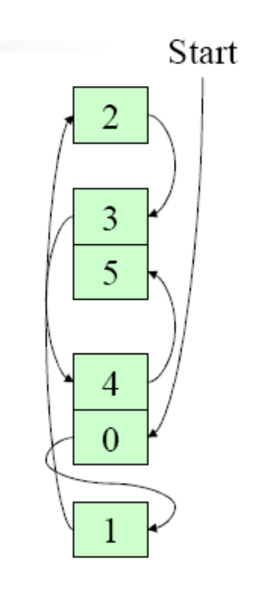
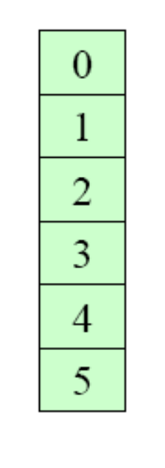
An Array
A Linked List

Slide 27
Basic Operations of Linked List
Operations of Linked List
  IsEmpty: determine whether or not the list is empty
  InsertNode: insert a new node at a particular position
  FindNode: find a node with a given value
  DeleteNode: delete a node with a given value
  DisplayList: print all the nodes in the list

Slide 28
An integer linked list
First Node of List
Last Node of List
list
10
13
5
2
data
next
NULL

Slide 29
Creating a List node
struct Node {
int data; // data in node
Node *next; // Pointer to next node
};
Node *p;
p = new Node;
p - > data = 10;
p - > next = NULL;
p
10

Slide 30
The NULL pointer
NULL is a special pointer value that does not reference any memory cell.
If a pointer is not currently in use, it should be set to NULL so that one can determine that it is not pointing to a valid address:
int *p;
p = NULL;

Slide 31
Adding a node to a list
Node *p, *q;
p = new Node;
p - > data = 10;
p - > next = NULL;
q = new Node;
q - > data = 6;
q - > next = NULL;
p - > next = q;
p
10
q
6
p
10
6
q

Slide 32
Accessing List Data
Node 1
Node 2
p
10
6
Expression
p
p - > data
p - > next
p - > next - > data
p - > next - > next
Value
Pointer to first node (head)
10
Pointer to next node
6
NULL pointer

Slide 33
Using typedef with pointers
struct Node {
int data; // data in node
Node *next; // Pointer to next node
};
typedef Node *NodePtr; // NodePtr type is a pointer
// to a Node
Node *p; // p is a pointer to a Node
NodePtr q; // q is a pointer to a Node

Slide 34
Building a list from 1 to n
struct Node {
int data;
Node *next;
};
Node *head = NULL; // pointer to the list head
Node *lastNodePtr = NULL; // pointer to last node in list
head
lastNodePtr

Slide 35
Creating the first node
Node *ptr; // declare a pointer to Node
ptr = new Node; // create a new Node
ptr - > data = 1;
ptr - > next = NULL;
head = ptr; // new node is first
lastNodePtr = ptr; // and last node in list
head
1
ptr
lastNodePtr

Slide 36
Adding more nodes
for (int i = 2; i < = n; i ++ ) {
ptr = new Node; //create new node
ptr - > data = i;
ptr - > next = NULL;
lastNodePtr - > next = ptr; // order is
lastNodePtr = ptr; // important
}
head
1
2
ptr
lastNodePtr

Slide 37
Initially
head
1
2
ptr
lastNodePtr
head
1
2
lastNodePtr
ptr
3
Create a new node with data field set to 3
Its next pointer should point to NULL

Slide 38
head
1
2
ptr
lastNodePtr
head
1
2
lastNodePtr
ptr
3
The next pointer of the node which was previously last should now point to newly created node “lastNodePtr->next=ptr”

Slide 39
head
1
2
ptr
lastNodePtr
head
1
2
lastNodePtr
ptr
3
The next pointer of the node which was previously last should now point to newly created node “lastNodePtr->next=ptr”
LastNodePtr should now point to the newly created Node “lastNodePtr = ptr;”

Slide 40
head
1
2
ptr
lastNodePtr
head
1
2
lastNodePtr
ptr
3
LastNodePtr should now point to the newly created Node “lastNodePtr = ptr;”

Slide 41
Re-arranging the view
head
1
2
3
ptr
lastNodePtr

Slide 42
Inserting a node in a list
head
2
5
8
prevNode
currNode
6
?
ptr
Step 1: Determine where you want to insert a node.
Step 2: Create a new node:
Node *ptr;
ptr = new Node;
ptr - > data = 6;

Slide 43
Node *ptr, *currNode, *prevNode ;
prevNode = head;
ptr = new Node;
ptr->data = 6;
ptr->next = NULL;
currNode = head->next;
While (currNode->data < ptr->data)
{
prevNode = currNode;
currNode = currNode->next;
}
Note:
when this loop terminates prevNode and currNode are at a place where insertion will take place. Only the “LINKS” or pointers of the list remain to be adjusted

Slide 44
Continuing the insert
Step 3: Make the new node point to the current Node pointer.
ptr - > next = currNode;
Step 4: Make previous node point to the new node:
prevNode - > next = ptr;
head
2
5
8
6
prevNode
ptr
currNode
Now The new link has been added in the linked list

Slide 45
Deleting a node from a list
head
2
5
8
prevNode
delNode
Step 1: Redirect pointer from the Node before the one to be deleted to point to the Node after the one to be deleted.
prevNode - > next = delNode - > next;
head
2
5
8
prevNode
delNode

Slide 46
Finishing the deletion
Step 2: Remove the pointer from the deleted link.
delNode - > next = NULL;
head
2
5
8
prevNodePtr
delNode
Step 3: Free up the memory used for the deleted node:
delete delNode;

Slide 47
List Operations - Summarized

Slide 48
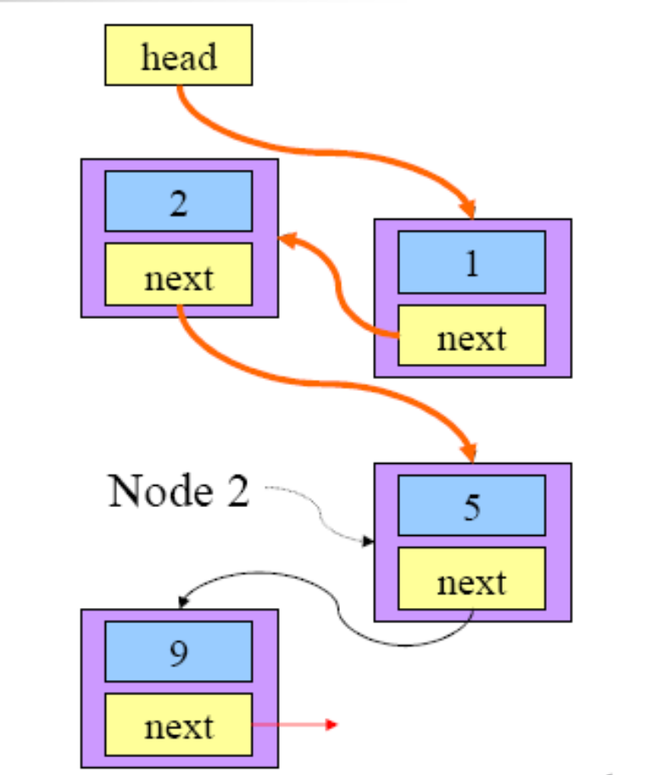
Traversing a Linked List

Slide 49
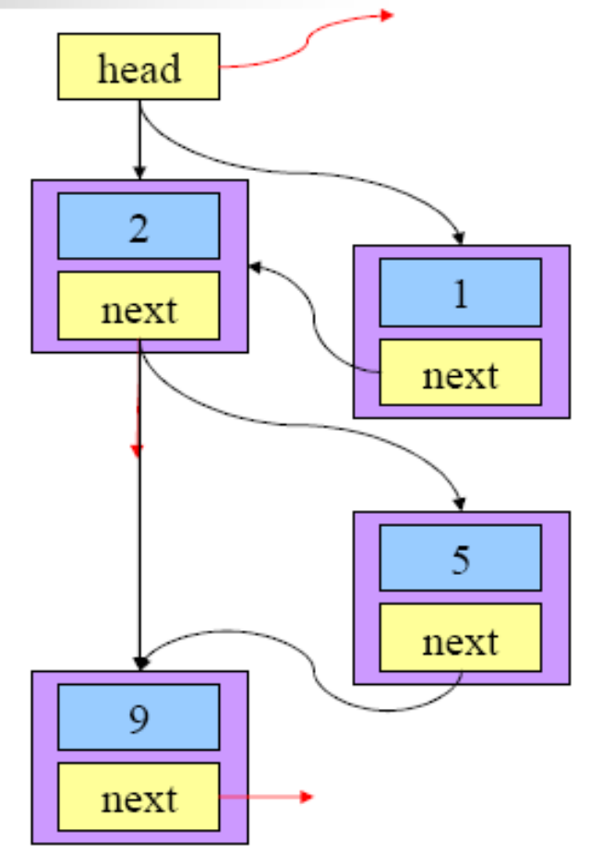
Insertion in a Linked List

Slide 50
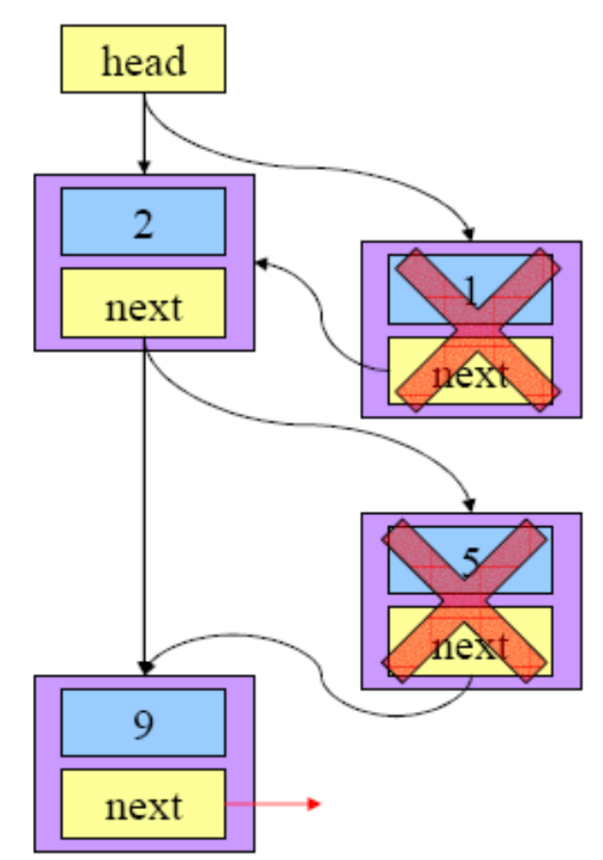
Deletion from a Linked List

